Slide 1

WAIŪ– A Celebration Of Sharing Happiness

Slide 2








WAIŪ : Mission, Vision & Values
Mission:
To create a global entrepreneur of hospitality industry, realizing pioneering advancements in established services and accomplish mutual growth for both our partners & customers
Vision:
WAIŪ is dedicated to provide modern & innovative solutions to our hospitality partners, via introduction of technology evolution in their offerings and opening avenues of inspiring new business horizons.
Values:
Innovation through Leadership : To spearhead hospitality experience enrichment, Consistently
Modernization & Elegance : To develop ultramodern hospitality business solutions
Focus & Evolution : Relentlessly strive to improve business value through performance

Slide 3
Product & Features
Our product & features include evolutionary aspects that allow enhanced customer experience at the premises of the restaurant, promoting socializing, interfacing, digital payments, media, credit and governance services.
More details on the features are as shared during the discussions & are available on demand, being covered under non-disclosure agreement.

Slide 4
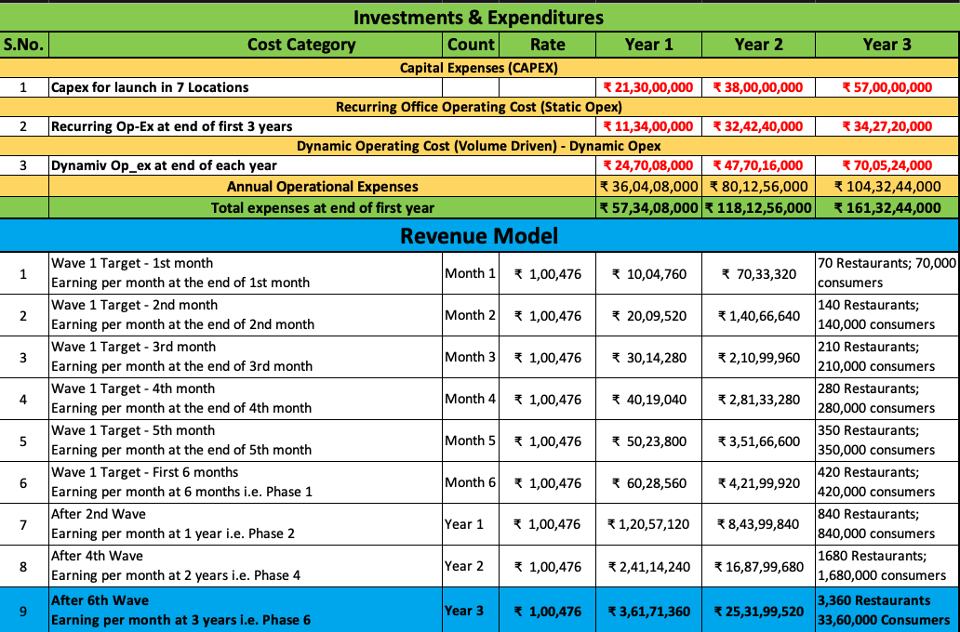
Expenses & Revenue Model

Slide 5
Our Team – In-Progress
Rajesh Karandikar – Founder & Owner, 24k Restaurant Network
Alok Sambuddha – Engineering Director, American Express (ex. Technology Leader – Infosys, ATOS)
Sanjay Kelapure – Hospitality Network Management (Hilton Group)
Shrikant Chatur – Governance Consultant (ex. VP Commercial - Cummins)
Shrikant Chepe – Technical Architect (Amway Head of Customer Solutions)
Rahul Patil – Security Specialist (Mastercard)
Raju Patil – Director Gaming Operations(Rockstar Games)
Chetan Oswal – Accounts & Legal Counsel
Partners:
IRSRD – Development, Governance, Technical Consultant, HR
Shah & Kirtane – Financial Modelling
KPMG – PPI Procurement Partner & Project Management
Sazinga Digital – Current Development Partner (Discussions ongoing with prominent vendors)

Slide 6






Question & Answers

